Slide 1
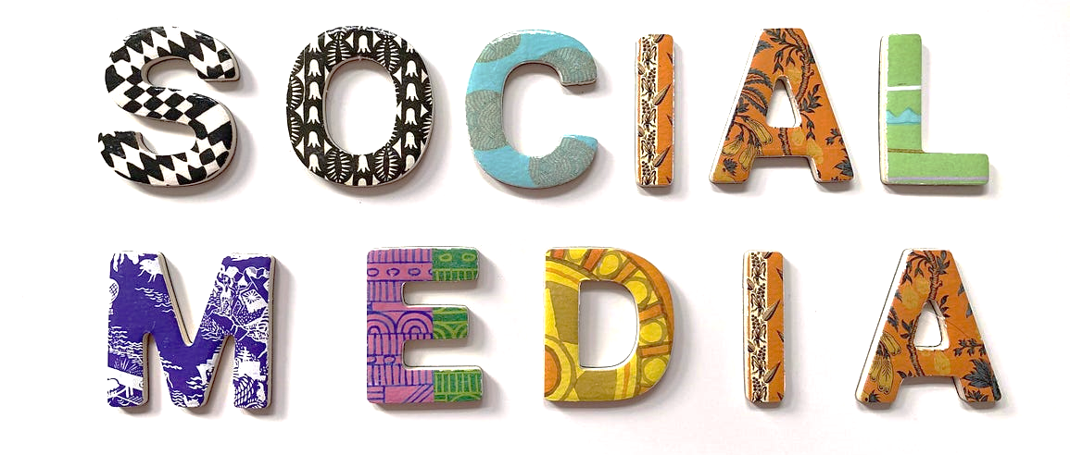
Module 9:
Social-Network Graphs
By Prof. Dr. Shanmugam Nandagopalan Ph. D
shanmugamnandagopalan@mfu.ac.th

Slide 2
Agenda
Introduction
Clustering of Social-Network Graphs
Direct Discovery of Communities
Social Networks as Graphs
Partitioning of Graphs
Graph Processing with Spark
Examples

Slide 3

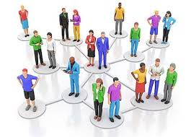
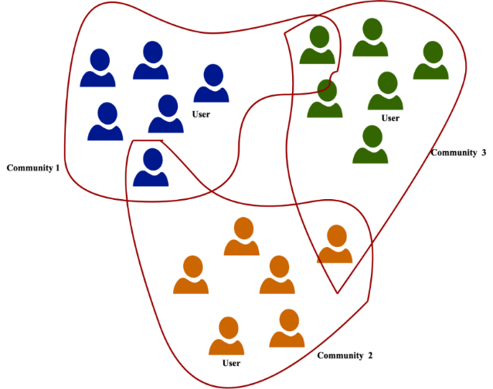
Introduction
A social network – “Facebook”, “X”, WhatsApp, LinkedIn, etc.
How to analyze social networks?
How to identify “communities,” i.e. subsets?
Communities usually overlap.
Example: you may belong to several communities of friends or classmates.

Slide 4

Social Media Communities

Slide 5
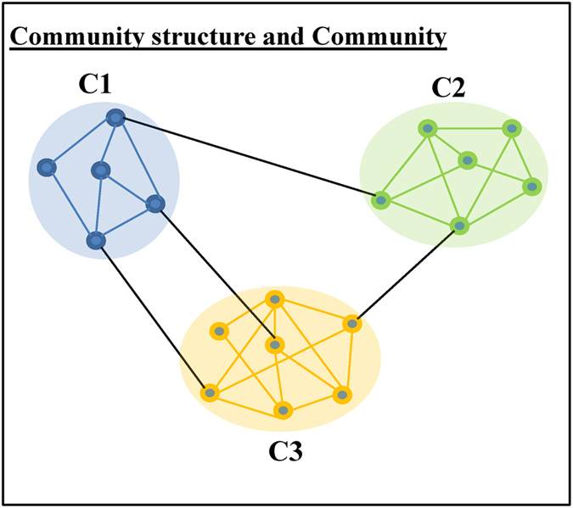
Social Networks as Graphs
Social networks - Graph model.
Nodes and edges of the graph tend to cluster in communities.
What is a Social Network?
  A group of users who are densely connected to each other, sharing common interests or characteristics, and have significantly fewer connections to individuals outside their group.
directed

Slide 6
A Property Graph
A property graph provides a rich abstraction for working with graph-oriented data.
two employees in a company and their relationship.

Slide 7
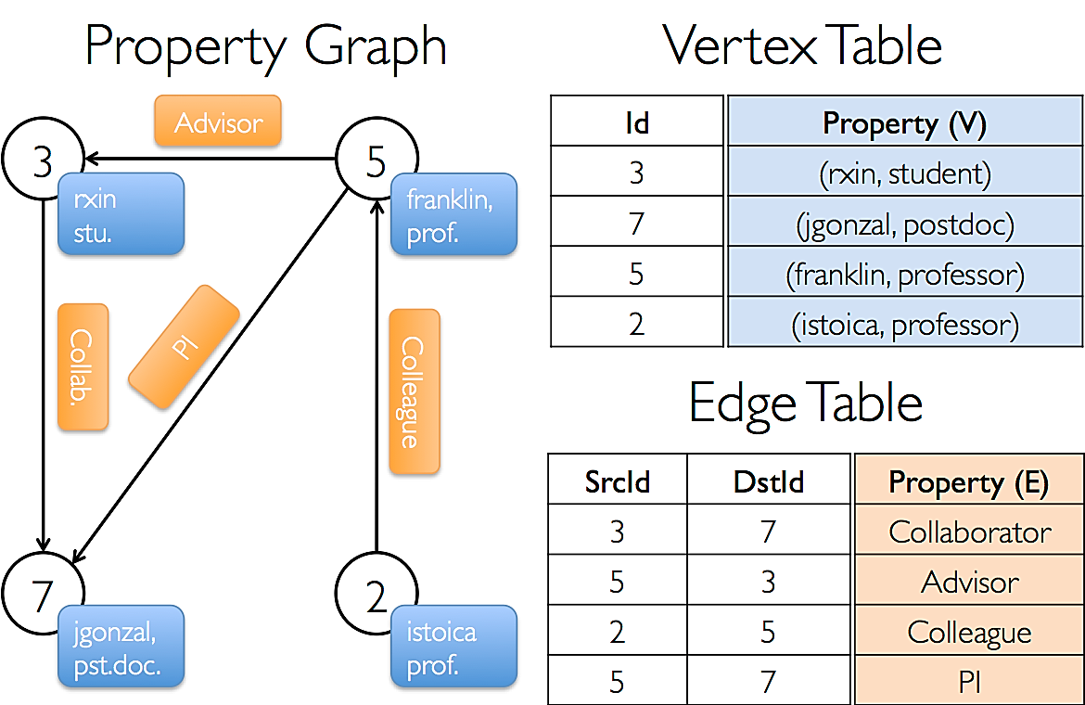
Example

Slide 8
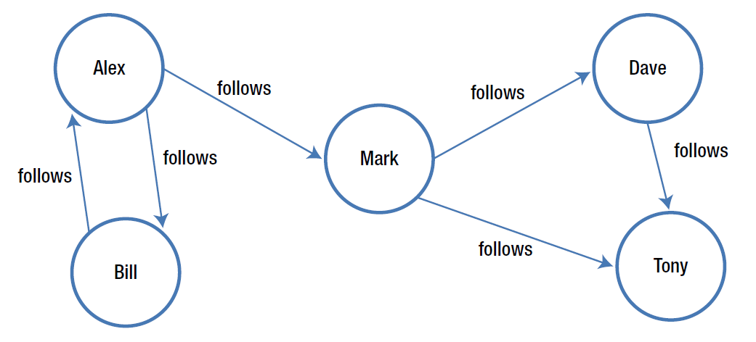
A Social Network Graph

Slide 9
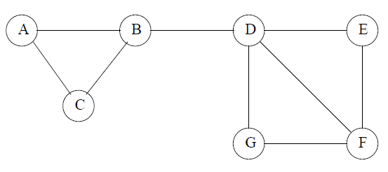
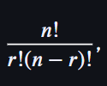
Characteristics of a Social Network
Collection of entities that participate in the network
There is at least one relationship between entities of the network
There is an assumption of nonrandomness or locality
Social Networks as Graphs
  social graph
  Example
  B is friends with A, C, and D.
  = 7!/(5!*2!)
  = 21 pairs of nodes
  “Locality of relationships“ - relationships between individuals or entities are primarily concentrated within a specific geographic area or community.

Slide 10



Varieties of Social Networks
Telephone Networks
Mobile Phone Networks
Email Networks

Slide 11
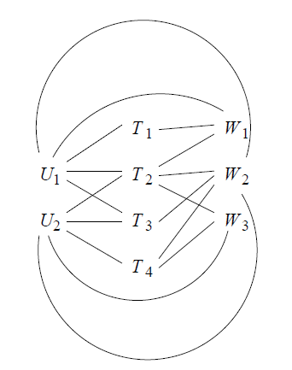
Graphs With Several Node Types
A tripartite graph representing users, tags, and Web pages
There are three sets of nodes, which we may think of as users {U1,U2}, tags {T1, T2, T3, T4}, and Web pages {W1,W2,W3}.
The edge (U1, T2) means that user U1 has placed the tag T2 on at least one page.

Slide 12
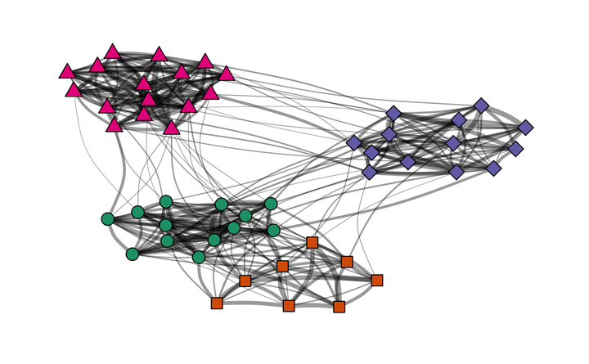
Clustering of Social-Network Graphs
Social networks contain communities of entities that are connected by many edges.
These typically correspond to groups of friends at school or groups of researchers interested in the same topic.
First step would be to define a distance measure
The edges of the graph have labels, these labels might be usable as a distance measure

Slide 13
Applying Standard Clustering Methods
Hierarchical (agglomerative) Clustering Method
  A method used to group social network nodes into communities by iteratively merging the closest clusters until a single cluster remains.
  This resulting hierarchical structure is known as dendrogram.
Point-assignment Clustering Method
  Point-assignment clustering, like K-means, groups data points by assigning them to the nearest cluster centroid, iteratively refining the clusters until convergence.
  Useful for analyzing social networks by identifying groups with similar characteristics or behaviors.

Slide 14
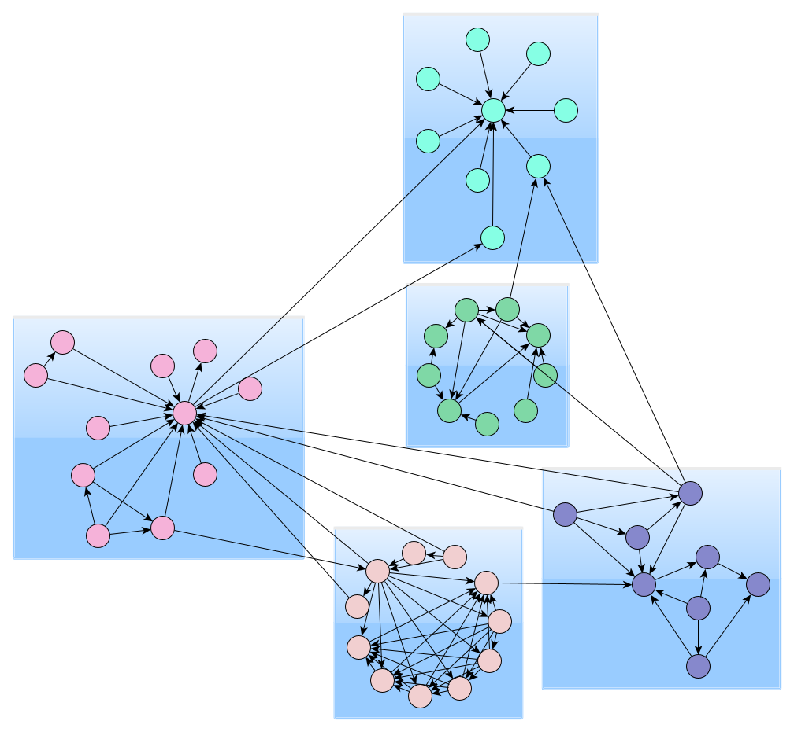
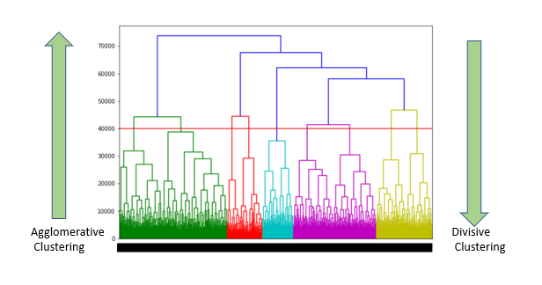
Sample Pictures
Point-Based Hierarchical-based

Slide 15
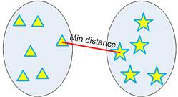
Hierarchical Clustering
Use distance matrix as clustering criteria. This method does not require the number of clusters k as an input, but needs a termination condition
Minimum distance clustering is also called as single linkage hierarchical clustering or nearest neighbor clustering. Distance between two clusters is defined by the minimum distance between objects of the two clusters, as shown below.

Slide 16
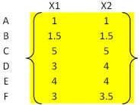
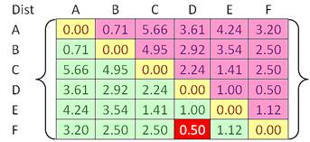
Example
For example, we have given an input distance matrix of size 6 by 6. This distance matrix was calculated based on the object features
In the beginning we have 6 clusters. Our goal is to group those 6 clusters such that at the end of the iterations, we will have only single cluster consists of the whole six original objects.

Slide 17
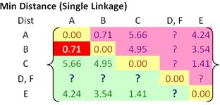
Example…
In each step of the iteration, we find the closest pair clusters. In this case, the closest cluster is between cluster F and D with shortest distance of 0.5. Thus, we group cluster D and F into cluster (D, F).
Update the distance matrix (see distance matrix below). Distance between ungrouped clusters will not change from the original distance matrix.
Now the problem is how to calculate distance between newly grouped clusters (D, F) and other clusters?

Slide 18
Example…
That is exactly where the linkage rule comes into effect. Using single linkage, we specify minimum distance between original objects of the two clusters.
Using the input distance matrix, distance between cluster (D, F) and cluster A is computed as
Distance between cluster (D, F) and cluster B is
Similarly, distance between cluster (D, F) and cluster C is
Finally, distance between cluster E and cluster (D, F) is calculated as

Slide 19
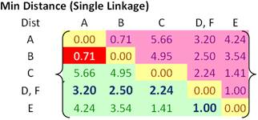
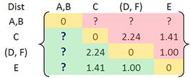
Example…
Updated matrix:
Now we update the distance matrix. Aside from the first row and first column, all the other elements of the new distance matrix are not changed.

Slide 20
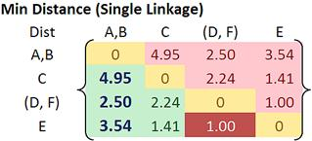
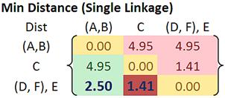
Example…

Slide 21
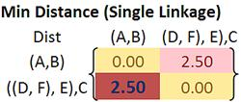
Example…

Slide 22
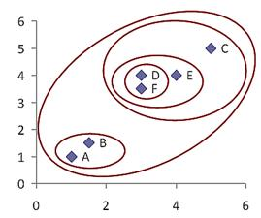
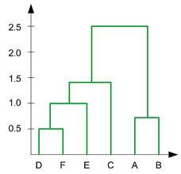
Example…
In the beginning we have 6 clusters: A, B, C, D, E and F
We merge cluster D and F into cluster (D, F) at distance 0.50
We merge cluster A and cluster B into (A, B) at distance 0.71
We merge cluster E and (D, F) into ((D, F), E) at distance 1.00
We merge cluster ((D, F), E) and C into (((D, F), E), C) at distance 1.41
We merge cluster (((D, F), E), C) and (A, B) into ((((D, F), E), C), (A, B)) at distance 2.50
The last cluster contain all the objects, thus conclude the computation
dendogram

Slide 23
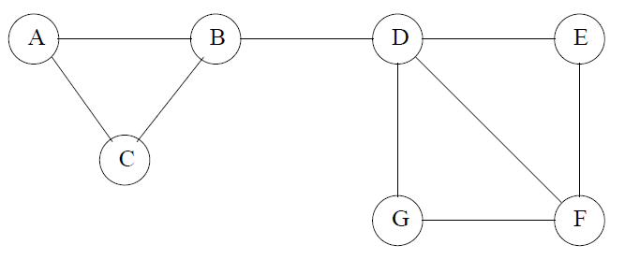
Example
There are two communities {A,B,C} and {D,E, F,G}.
Subcommunities-{D,E, F} and {D, F,G}
With hierarchical clustering, we will combine B and D.
A point-assignment approach will assume all edges are at the same distance and hence assign wrong cluster.

Slide 24
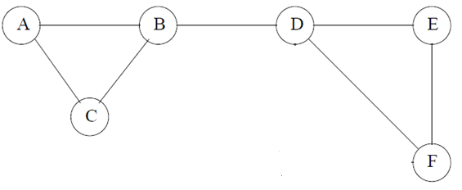
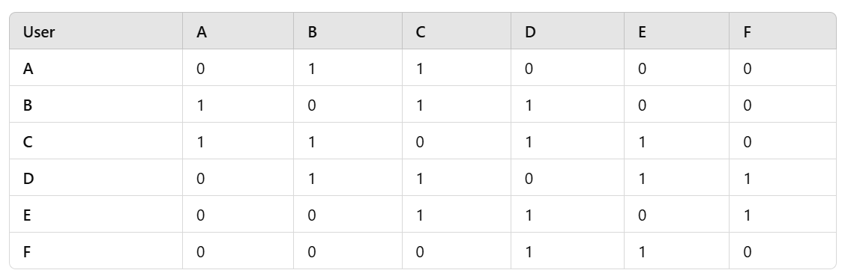
K-Means on Social Network
Step 1:
Consider the Graph->
The Adjacency Matrix

Slide 25
Step 2
Choose k = 2
Use the Euclidean distance
Initialize Centroids
  Randomly select two initial centroids from the dataset.
  Let’s assume Users A and D are chosen as initial centroids.
Example calculation for User B:
  Distance to A = √((1-0)² + (0-1)² + (1-1)² + (1-0)² + (0-0)² + (0-0)²) = √(1+1+0+1+0+0) = √3
  Distance to D = √((1-0)² + (1-1)² + (0-1)² + (1-0)² + (0-1)² + (0-1)²) = √(1+0+1+1+1+1) = √5
Since B is closer to A, it is assigned to Cluster 1.

Slide 26
Step 3
After running K-Means, we get two clusters:
  Cluster 1: A, B, C
  Cluster 2: D, E, F
This means:
  Cluster 1 (A, B, C): Users who are more densely connected among themselves.
  Cluster 2 (D, E, F): A separate subgroup with stronger internal connections.

Slide 27
Betweenness
Technique to find communities in social networks.
Definition: the betweenness of an edge (a, b) to be the number of pairs of nodes x and y such that the edge (a, b) lies on the shortest path between x and y.
That is, the edge (a, b) runs between two different communities; that is, a and b do not belong to the same community.
Highest betweenness is Edge {B, D}

Slide 28
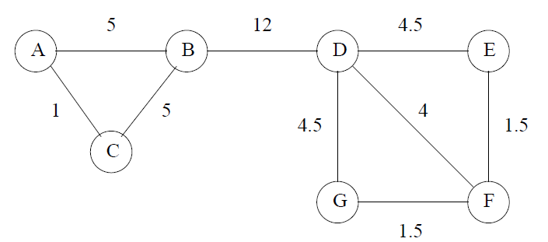
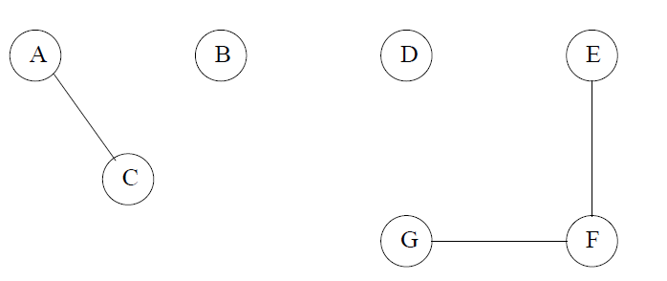
Betweenness to Find Communities
Since edge {B,D} has the highest betweenness, it is removed first.
So we get two communities {A,B,C}, {D,E,F,G}

Slide 29
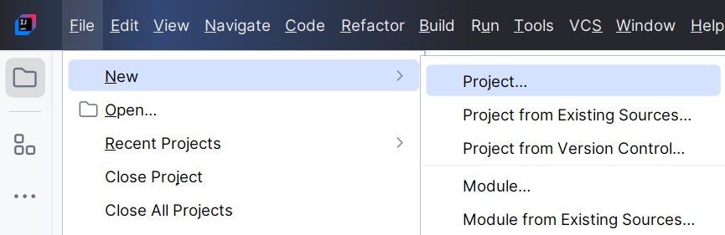
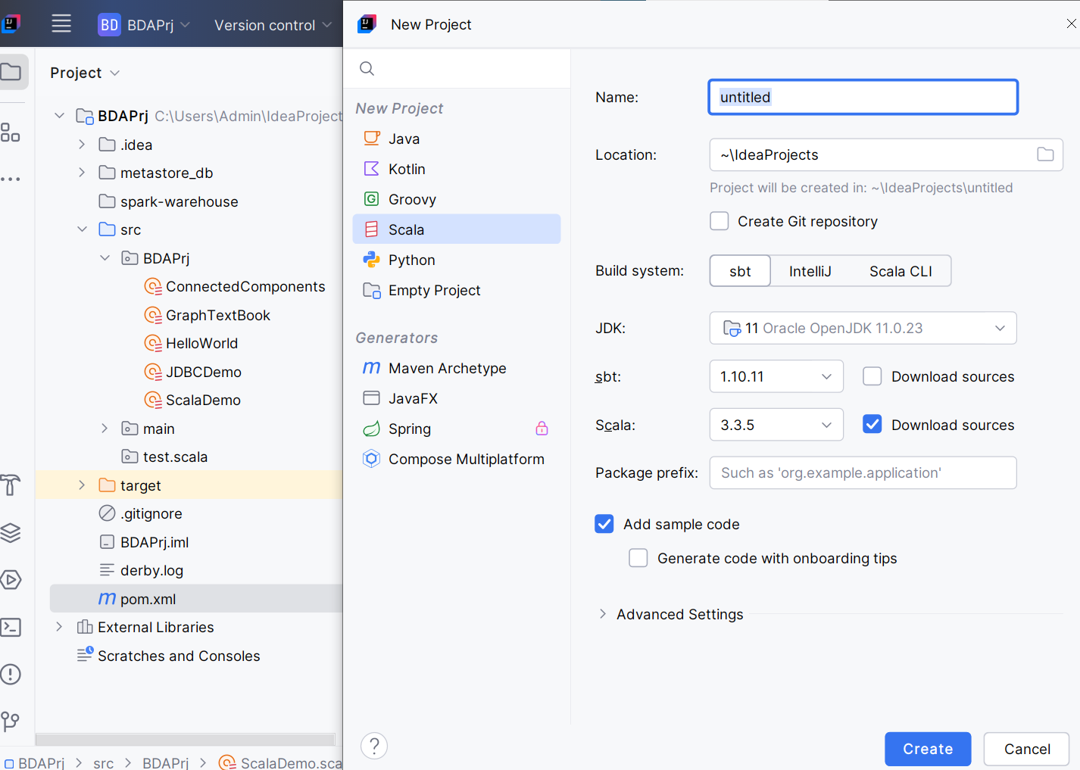
Creating Projects in IntelliJ
Projects for Scala Programming

Slide 30
Creating Projects in IntelliJ
Projects for Python Programming

Slide 31
What is GraphX?
GraphX is a distributed graph analytics framework.
It is a Spark library that extends Spark for large-scale graph processing.
It provides a higher-level abstraction for graphs analytics than that provided by the Spark core API.

Slide 32
Graph Analytics Pipeline
a) Read raw data.
b) Preprocess data (e.g., cleanse data).
c) Extract vertices and edges to create a property graph.
d) Slice a subgraph.
e) Run graph algorithms.
f) Analyze the results.
g) Repeat steps e and f with another slice of the graph

Slide 33
Resilient Distributed Datasets (RDDs)
RDD is a fault-tolerant collection of elements that can be operated on in parallel.
There are two ways to create RDDs:
  parallelizing an existing collection in your driver program
  referencing a dataset in an external storage system, such as a shared filesystem, HDFS.
Parallelized Collections
  Parallelized collections are created by calling SparkContext’s parallelize method on an existing collection in your driver program.
val data = Array(1, 2, 3, 4, 5)
val RDDdata = sc.parallelize(data)

Slide 34
Creating a Graph with Scala
package BDAPrj
import org.apache.spark.graphx._
import org.apache.spark.SparkConf
import org.apache.spark.SparkContext

Slide 35
Creating a Spark Context
object GraphTextBook {
def main(args: Array[String]): Unit = {
// Create a SparkConf object
val conf = new SparkConf()
.setAppName("Graph Creation")
// Adjust "local[*]" based on your cluster setup
.setMaster("local[*]") // Create SparkContext
val sc = new SparkContext(conf)

Slide 36
Create Data for Graph
case class User(name: String, age: Int)
val users = List((1L, User("Alex", 26)), (2L, User("Bill", 42)), (3L, User("Carol", 18)),
(4L, User("Dave", 16)), (5L, User("Eve", 45)), (6L, User("Farell", 30)),
(7L, User("Garry", 32)), (8L, User("Harry", 36)), (9L, User("Ivan", 28)),
(10L, User("Jill", 48))
)
val usersRDD = sc.parallelize(users)
val follows = List(Edge(1L, 2L, 1), Edge(2L, 3L, 1), Edge(3L, 1L, 1), Edge(3L, 4L, 1),
Edge(3L, 5L, 1), Edge(4L, 5L, 1), Edge(6L, 5L, 1), Edge(7L, 6L, 1),
Edge(6L, 8L, 1), Edge(7L, 8L, 1), Edge(7L, 9L, 1), Edge(9L, 8L, 1),
Edge(8L, 10L, 1), Edge(10L, 9L, 1), Edge(1L, 11L, 1)
)
val followsRDD = sc.parallelize(follows)
val defaultUser = User("NA", 0)

Slide 37
Create Graph
// Create the Graph
val socialGraph = Graph(usersRDD, followsRDD, defaultUser)
// Print no. of edges & vertices
val numEdges = socialGraph.numEdges
val numVertices = socialGraph.numVertices
println("No. of vertices = " + numVertices)
println("No. of Edges = " + numEdges)
for (edge <- socialGraph.edges.collect()) {
println(s"Edge: ${edge.srcId} -> ${edge.dstId}, Attribute: ${edge.attr}")
}
}
}

Slide 38
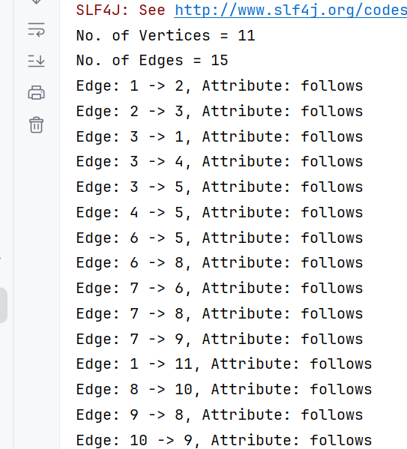
Output

Slide 39
Graphs using PySpark
# Create vertices DataFrame
vertices = spark.createDataFrame([
(1, "Alice"),
(2, "Bob"),
(3, "Charlie"),
(4, "Darwin")
], ["id", "name"])
# Create edges DataFrame
edges = spark.createDataFrame([
(1, 2, "friend"),
(2, 3, "friend"),
(2, 4, "follows"),
(3, 4, "likes")
], ["src", "dst", "relationship"])
# Create GraphFrame
g = GraphFrame(vertices, edges)
What is GraphFrames?
GraphFrames is a library in Apache Spark that makes it easy to work with graphs and graph-parallel computations.
It allows you to represent graphs using DataFrames and provides various efficient algorithms for graph processing.

Slide 40
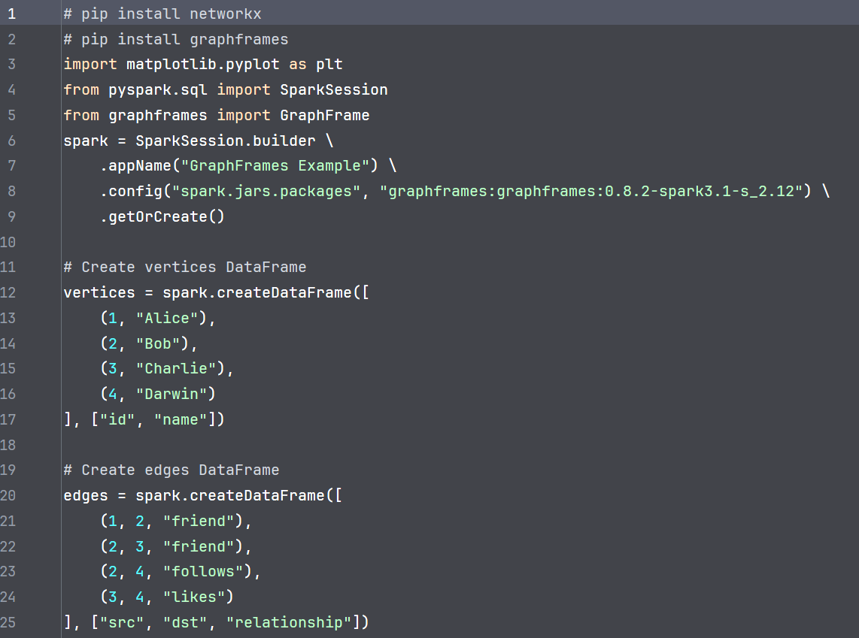
Graphs using PySpark - Example

Slide 41
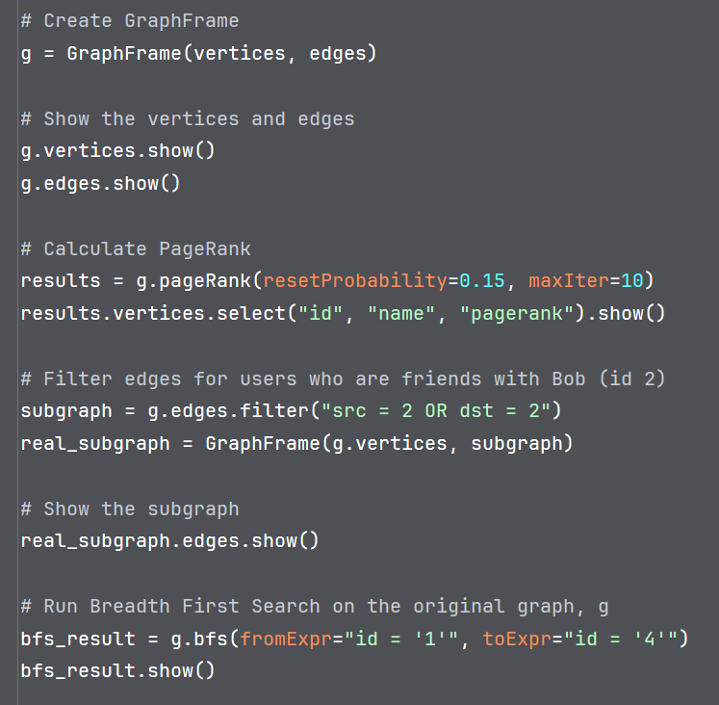

Slide 42
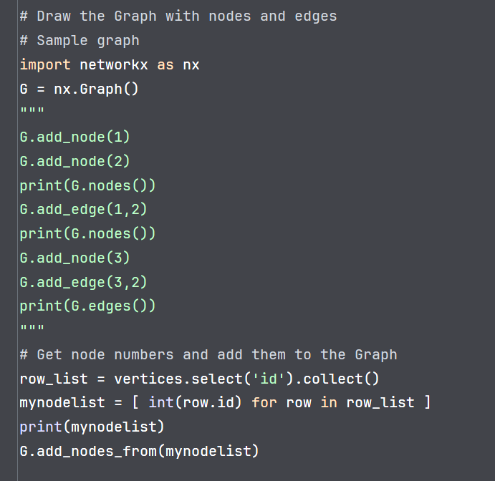

Slide 43
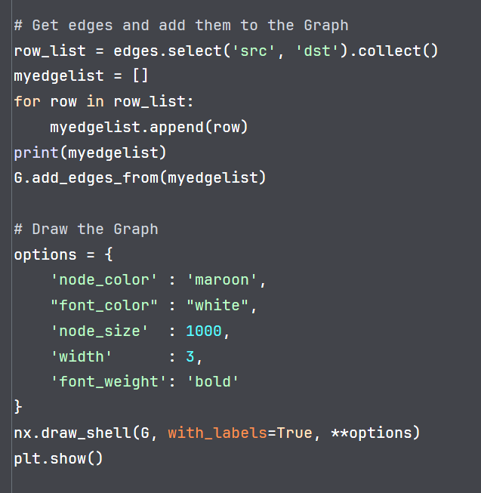

Slide 44
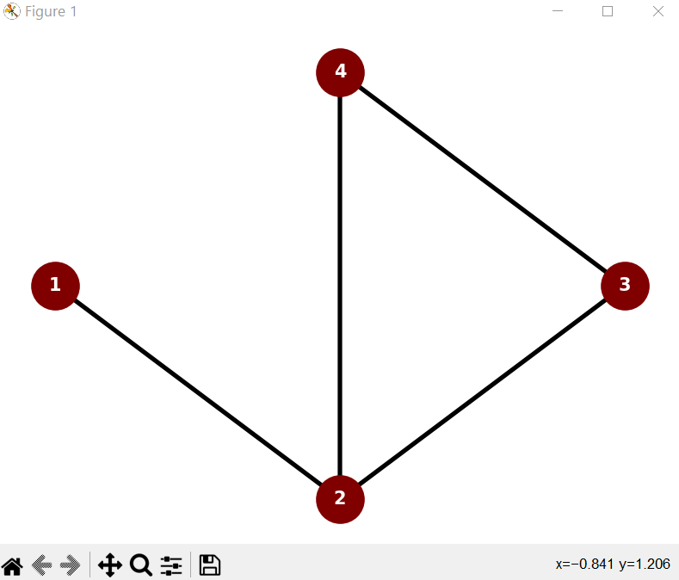
Output

Slide 45
NetworkX
GraphX
Language: Python
Purpose: For creating, manipulating, and analyzing graphs in Python.
Scalability: Primarily designed for in-memory graph processing, making it suitable for smaller to medium-sized graphs.
Algorithm Library: Offers a wide range of graph algorithms and tools for various analysis tasks.
Visualization: Provides basic graph visualization capabilities, but for more complex or large graphs, use dedicated visualization tools.
Example: nx.Graph() for creating a graph object.
Language: Scala (part of Apache Spark)
Purpose: For handling large-scale graph data and performing distributed graph computations using Apache Spark.
Scalability: Designed for processing graphs that don't fit into memory, leveraging Spark's distributed computing capabilities.
Algorithm Library: Provides a set of graph algorithms and operators, including Pregel for distributed graph computations.
Visualization: Doesn't have built-in visualization tools, but can integrate with other visualization tools like Gephi.
Example: GraphV,E for creating a graph object.

Slide 46
Thank You

